Slide 1
ERTS Final Assessment – Task 1
Kalyan Sudra - eo20203,
Khush Shah - bi20475,
Ronaldo Balram - nz20469,
Qijia Tang – dm22509

Slide 2
Practical elements
Show that the robot can move around effectively in both modes of operations
Show that you have made use of the LED & Switches
Is there nay difference in operation when you robot works in polling mode and interrupt mode?

Slide 3
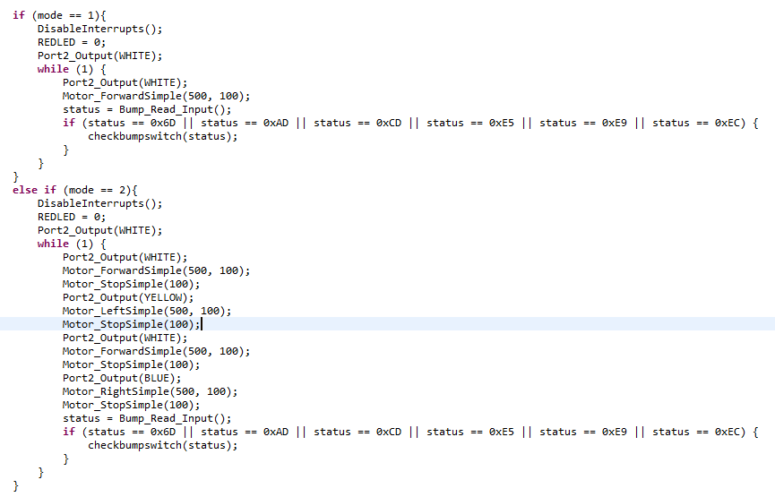
Polling
How do you implement operation of robot with polling? Why?
Interrupts are inefficient when the device interrupts the CPU frequently, so in such cases it is better to use polling.

Slide 4
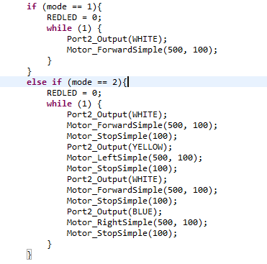
Interrupts
How do you implement operation of robot with interrupts? Why?
The device informs the CPU that it needs attention whereas in polling, the CPU constantly checks the device, wasting CPU cycles, so generally, interrupts are more efficient.

Slide 5
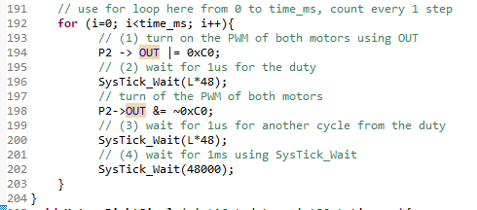
Delays
Where have delays been used? Why?
The delays are controlled by the duty cycle, determining the speed of the motors.

Slide 6
CPU Usage
How have you measured the CPU utilization?
CPU Utilization = (C/(48,000,000*T)) *100%
Period of the Interruption(T) , number of the Bump Switch (No.)
Interruption Computation time in cycles (C)
Assume T = 5
No. C Utilization
147667075 61.53%
164883882 68.70%
182100689 75.88%
182100696 75.88%
164883893 68.70%
147667096 61.53%

Slide 7
CPU Usage
Switch motors on or off (a): 16
Wait for duty cycle (b): 62028
Wait for 1ms (c): 48074
CPU utilisation: (a*2)/(b*2+c) *100% = 0.02%

